Slide 1
TA Training
CS 163/164
Albert Lionelle
Rachel Masters / Jessica Bahny
Colorado State University
Computer Science Department
Notes:
Day 1

Slide 2
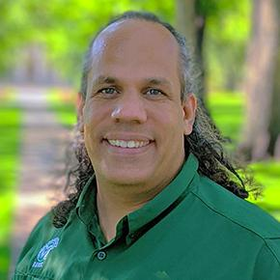

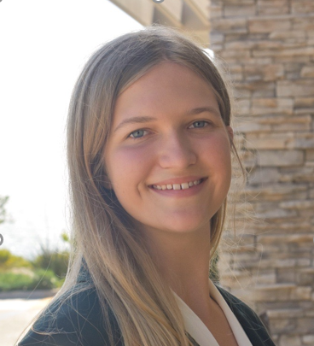
Introductions
Instructors:
Albert Lionelle
Lead TA's:
Rachel Masters
Jessica Bahny
Albert Lionelle
Rachel Masters
Jessica Bahny

Slide 3
Course Structure
Format
Lectures
In person lectures
Labs
Two TA's per room, one “primary”
164 Labs will be more "hands-off" similar to helpdesk
Helpsession
In person except for Thursday
Two TA's per session
Helpdesk
On Teams and in CSB 120
T TH Sat - Virtual on Teams
W F Sun - In-person in CSB 120
Model
Spiral Learning Model
Revisit subjects multiple times
Notes:
Have Albert describe course structure, research, and spiral learning model

Slide 4
Teaching Model
Spiral Model
Instructors: Albert Lionelle (163)
New labs, schedule, and assignments
Based on Psychology of Learning Spacing Interweaving Practiced Recall Elaboration Reflection
4-week cycles (units) where concepts resurface

Slide 5
Introductions
Name
Major
New or Returning?
Favorite Hobby

Slide 6
3 Things Popcorn
Question: What do you enjoy?
List 3 things then popcorn to someone who has not gone yet.

Slide 7
Primary Duties for UTAs
Teaching labs and help sessions
Staffing help desk hours
Answering questions on Teams and networking with students
Preparing for lab and helpdesk by reviewing course concepts, assignments, and planning teaching approach
Meeting with other TAs and instructors weekly

Slide 8
CS 163/4 Layout

Slide 9
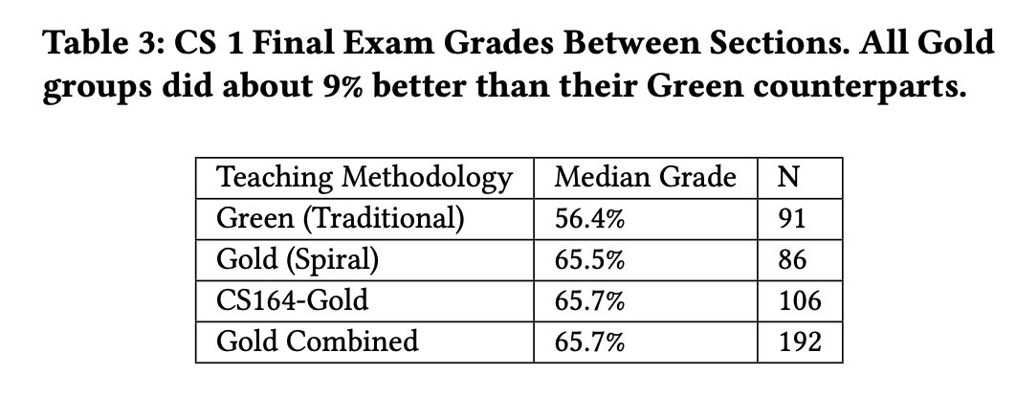
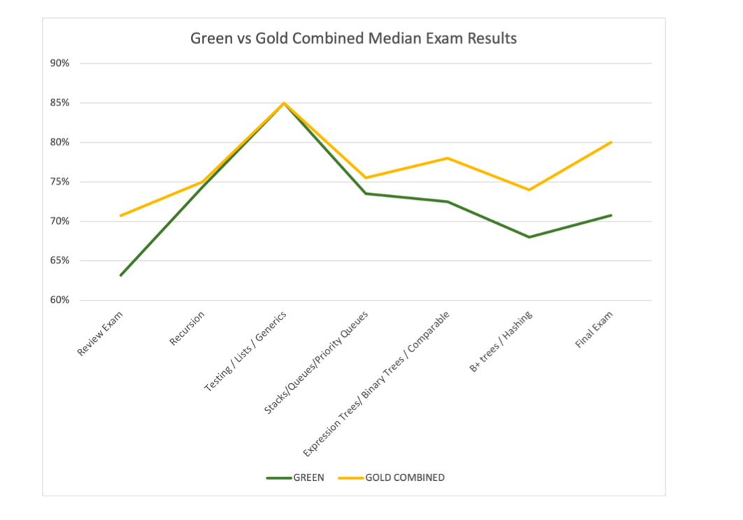
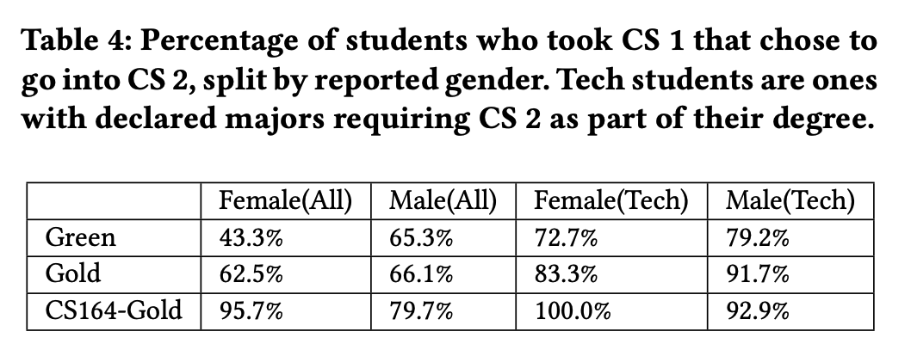
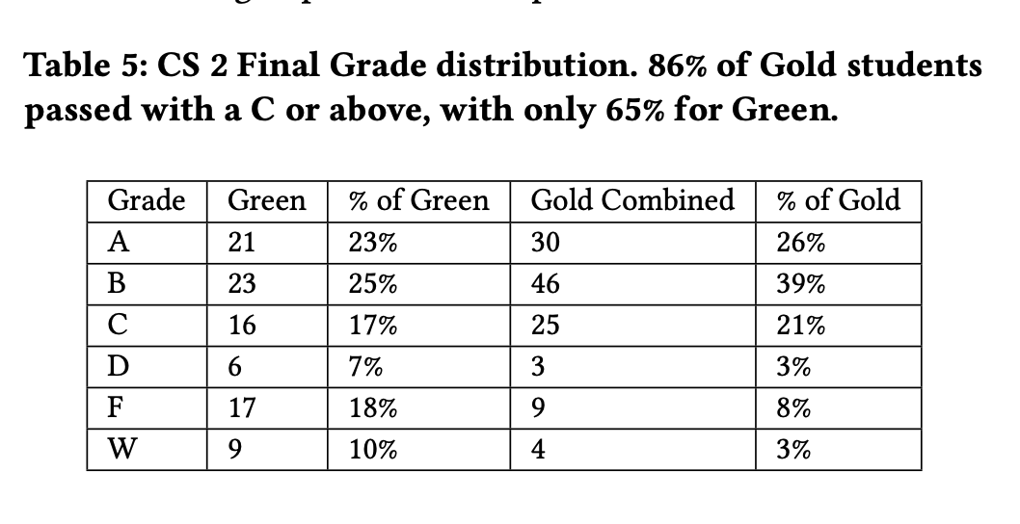
How did the Spiral Go? Good!

Slide 10
Changes in CS 163/4 Since Last semester
Updated Labs
Tuesday labs are shorter assignments designed to be completed during lab time
Thursday labs are designed to be “take home” assignments
Updated Support For Students
Bringing back the help sessions
Less helpdesk hours
Community Teams, Primary TA Networking hour
Reordering of Topics
Arrays are now much later in the semester
Updated Support For TA’s
Less helpdesk hours
No helpdesk on Mondays (large assignments are due on Mondays)

Slide 11
Teaching Methods
Notes:
Day 2

Slide 12
General Recommendations
Remember that students come from a variety of backgrounds and skill levels and that certain concepts click with some students and other concepts don’t.
Be patient and kind - always.
Find different ways to explain things, and be attuned enough to students to know when one explanation isn’t working.
Discuss with other TAs to see how they explain something to get ideas.

Slide 13
One on One Teaching
Recommended Strategies and Tips for Handling Angry/Upset Students

Slide 14
Recommended Strategies for One-on-One
Help students find the right answer, don’t give them the right answer. Here’s some tips as to how:
Ask questions like:
Why did you structure your code this way?
What is the proper syntax or use of this variable/object/statement?
What is the goal of this method/exercise?
Encourage students to read or reread the instructions if they are completely lost, then talk them through potential approaches/steps.
Have them explain what they think they need to do or what they want to try and do, then how they need to do it.
Rubber duck method

Slide 15
Tips for How to Handle Angry/Upset Students
Validate their feelings of frustration with statements like:
I hear you, this is a challenging topic.
This is a challenging topic, many students struggle with it too.
Allow them to have a cooldown period, or suggest to them taking a break.
Many students get frustrated that you can’t just tell them the right answer.
Consider explaining why you’re not going to do that, and how it’ll help them now but hurt them long term.
Many students get upset and down on themselves for “just not getting it”
Consider reassuring them that a lot of this doesn’t come naturally or easily, and that you’re there to support them.

Slide 16
Small Group Teaching
Encourage students to work together
Problem solve as a group
Ask leading questions and point them in the right direction if group is stuck
If one student has grasped a concept, have them explain it to another who's struggling

Slide 17
Large Group Teaching
Go over general concepts using slides or some other visual
Provide more specific examples with code, and explain how you’re coming up with what to write in the code
Pace yourself appropriately to find a happy medium for all skill levels
Ask questions and allow enough wait time for students to think and respond
Go over common mistakes you’ve seen in the past

Slide 18
Helpdesk
Virtual/In Person Combination
Channel in Teams
When working virtually:
Alright to help more than one student at a time... but pace yourself
Students often are delayed in responding anyway
If you find the need to go into video chat
Ask the student to wait while you finish with the other students you are currently working with
Don't add new students
Use video chat for screen sharing (very helpful)

Slide 19
What would you do?
SITUATION: A student is becoming visibly/audibly upset while getting help. They are not responding well to your approach while assisting them. What do you do?
SITUATION: A student on a video call is asking questions beyond the allotted time. What do you do?
SITUATION: A student is asking questions that you are unable to answer without giving away the solution. What do you do?
SITUATION: Two students are copying code between their computers in the lab for the current assignment. What do you do?

Slide 20
